Slide 1

CSE- 321
Software Engineering
Lecture : 08 Project Management
Fahad Ahmed
Lecturer, Dept. of CSE
E-mail: fahadahmed@uap-bd.edu

Slide 2
Lecture Outlines
Software project management
The 4 P’s
Management activities
Project planning
Risk management
Requirements Engineering (RE)
Functional and Non-functional Requirements
Requirements Engineering Process
Feasibility Studies
Requirements Elicitation and Analysis
Requirements Management

Slide 3
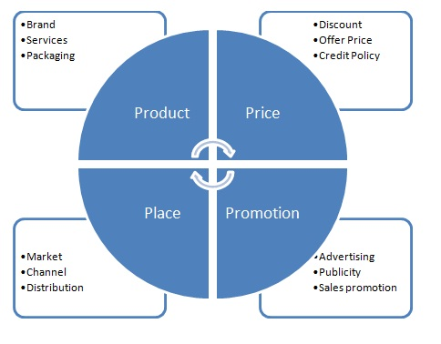
4Ps in Marketing

Slide 4
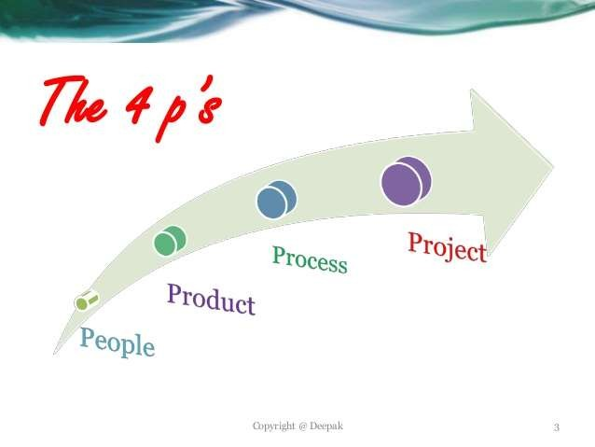
Software Project Management : The 4 P’s
People — the most important element of a successful project :Developers, project managers, testers, ..etc.
Product — the software to be built
Process — the set of framework activities and software engineering tasks required to get the job done.
Project — all work required to make the product a reality

Slide 5
Software Project Management : The 4 P’s
People — People of a project includes from manager to developer, from customer to end user. But mainly people of a project highlight the developers. It is so important to have highly skilled and motivated developers that the Software Engineering Institute has developed a People Management Capability Maturity Model (PM-CMM).
Product — Product is any software that has to be developed. To develop successfully, product objectives and scope should be established, alternative solutions should be considered, and technical and management constraints should be identified. Without this information, it is impossible to define reasonable and accurate estimates of the cost, an effective assessment of risk, a realistic breakdown of project tasks or a manageable project schedule that provides a meaningful indication of progress.

Slide 6
Software Project Management : The 4 P’s
Process — A software process provides the framework from which a comprehensive plan for software development can be established. A number of different tasks sets— tasks, milestones, work products, and quality assurance points— enable the framework activities to be adapted to the characteristics of the software project and the requirements of the project team.
Project —The project includes all and everything of the total development process and to avoid project failure. Here, the project manager has to do some job.

Slide 7
Software Project Management
Software Project Management
Concerned with activities involved in ensuring that software is delivered on time and on schedule and in accordance with the requirements of the organisations developing and procuring the software.
Project management is needed because software development is always subject to budget and schedule constraints that are set by the organisation developing the software.

Slide 8
Software Project Management
Management activities
Proposal writing.
Project planning and scheduling.
Project costing.
Project monitoring and reviews.
Personnel selection and evaluation.
Report writing and presentations.

Slide 9
Project planning
Probably the most time-consuming project management activity.
Continuous activity from initial concept through to system delivery. Plans must be regularly revised as new information becomes available.
Various different types of plan may be developed to support the main software project plan that is concerned with schedule and budget.

Slide 10
Project plan structure
Most plans should include the following sections:
Introduction.
Project organisation.
Risk analysis.
Hardware and software resource requirements.
Work breakdown.
Project schedule.
Monitoring and reporting mechanisms.

Slide 11
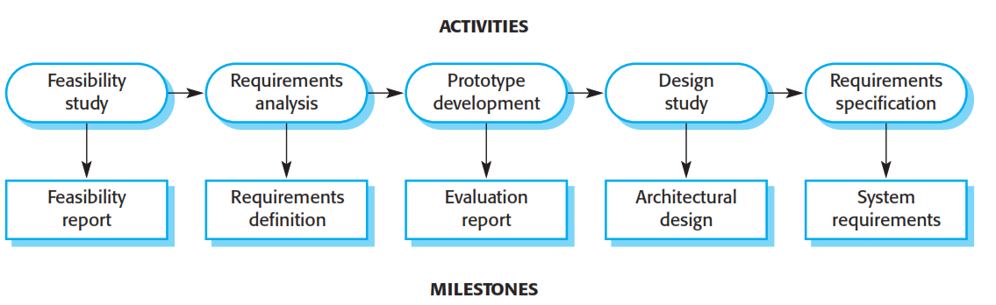
Milestones and Deliverables
Milestones are the end-point of a process activity.
Deliverables are project results delivered to customers.

Slide 12
Bar charts and activity networks
Graphical notations used to illustrate the project schedule.
Show project breakdown into tasks. Tasks should not be too small. They should take about a week or two.
Activity charts show task dependencies and the critical path.
Bar charts show schedule against calendar time.

Slide 13
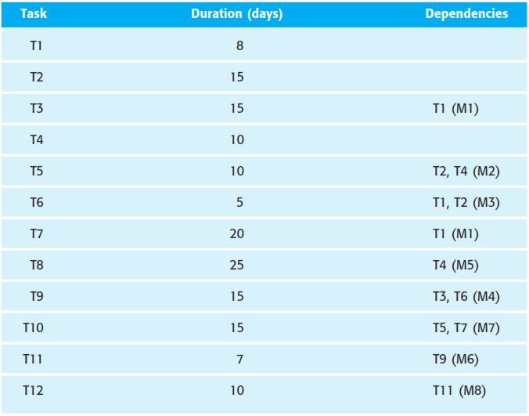
Task durations and dependencies

Slide 14
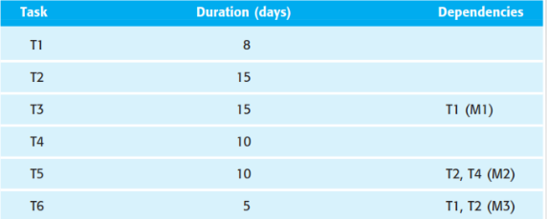
Activity network
15 days
T1
M1
T3
8 days
M3
T6
Start
5 days
T2
15 days
M2
T5
10 days
10 days
T4

Slide 15
Activity network
10th day
23th
day
25th
20th
day
15 days
T1
M1
T3
8 days
M3
T6
Start
5 days
T2
15 days
M2
T5
10 days
10 days
T4

Slide 16
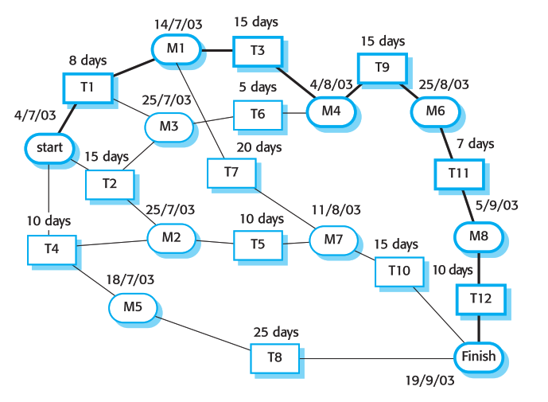
Activity network

Slide 17
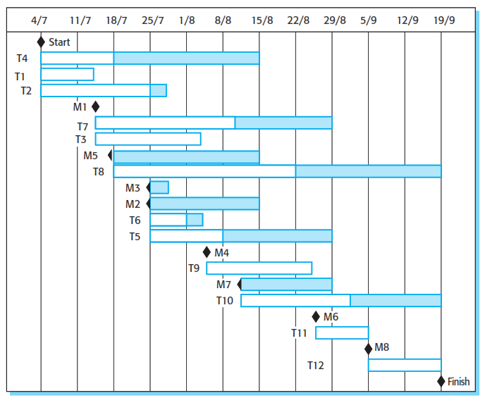
Activity timeline

Slide 18
Risk management
Risk management is concerned with identifying risks and drawing up plans to minimise their effect on a project.
A risk is a probability that some adverse circumstance will occur
Project risks affect schedule or resources;
Product risks affect the quality or performance of the software being developed;
Business risks affect the organisation developing or procuring the software.

Slide 19
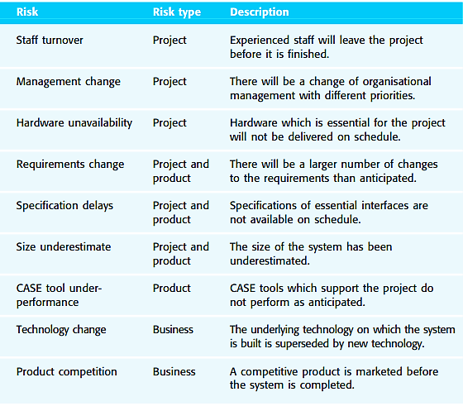
Possible software risks

Slide 20
The risk management process
Risk identification
Identify project, product and business risks;
Risk analysis
Assess the likelihood and consequences of these risks;
Risk planning
Draw up plans to avoid or minimise the effects of the risk;
Risk monitoring
Monitor the risks throughout the project;

Slide 21
The risk management process
Risk identification
There are at least six types of risk that can arise:
Technology risks : Risks that derive from the software or hardware technologies that are used to develop the system.
People risks: Risks that are associated with the people in the development team.
Organisational risks: Risks that derive from the organisational environment where the software is being developed.
Tools risks: Risks that derive from the CASE tools and other support software used to develop the system.
Requirements risks: Risks that derive from changes to the customer requirements and the process of managing the requirements change.
Estimation risks: Risks that derive from the management estimates of the system characteristics and the resources required to build the system.

Slide 22
The risk management process
Risk analysis
During the risk analysis process, we have to consider each identified risk and make
a judgement about the probability and the seriousness of it. There is no easy way
to do this—we must rely on your own judgement and experience, which is why
experienced project managers are generally the best people to help with risk management.
These risk estimates should not generally be precise numeric assessments. But should be based around a number of bands:
• The probability of the risk might be assessed as
very low (<10%), low (10–25%), moderate (25-50%), high (50–75%) or very high (>75%).
• The effects of the risk might be assessed as catastrophic, serious, tolerable or
insignificant.

Slide 23
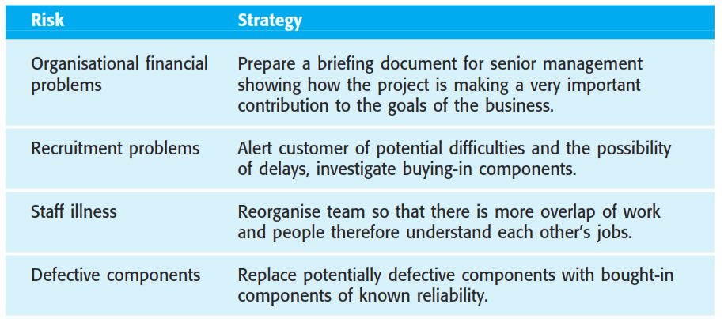
The risk management process
Risk Management strategies

Slide 24
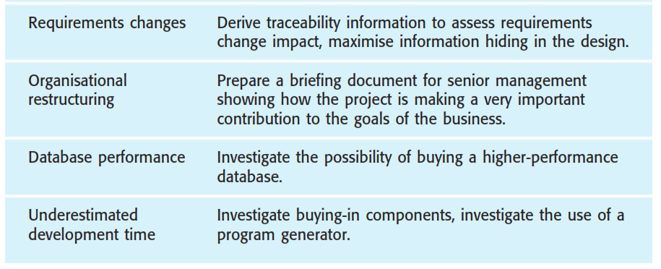
The risk management process
Risk Management strategies

Slide 25
Lecture Outlines

Slide 26
Requirements Engineering (RE)
The requirements for a system are the descriptions of the services provided by the system and its operational constraints.
The process of finding out, analyzing, documenting and checking these services and constraints is called requirements engineering (RE).
User requirements
Statements in natural language plus diagrams of the services the system provides and its operational constraints.
System requirements
A structured document setting out detailed descriptions of the system’s functions, services and operational constraints. Defines what should be implemented so may be part of a contract between client and contractor.

Slide 27
Functional and non-functional requirements
Functional requirements
Statements of services the system should provide, how the system should react to particular inputs and how the system should behave in particular situations.
Non-functional requirements
constraints on the services or functions offered by the system such as timing constraints, constraints on the development process, standards, etc.
Domain requirements
Requirements that come from the application domain of the system and that reflect characteristics of that domain.

Slide 28
Requirements engineering process
The goal of the requirements engineering process is to create and maintain a system requirements document.
The overall process includes four high-level requirements engineering sub-processes.
Requirements elicitation;
Requirements analysis;
Requirements validation;
Requirements management.

Slide 29
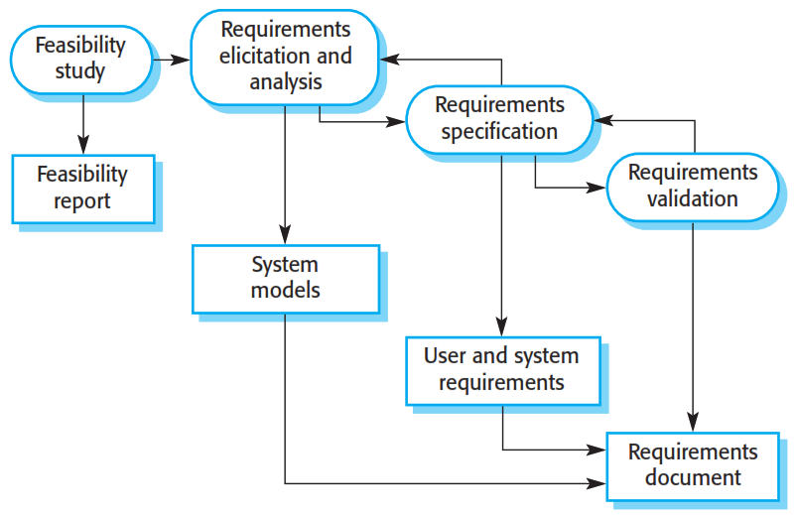
Requirements engineering process

Slide 30
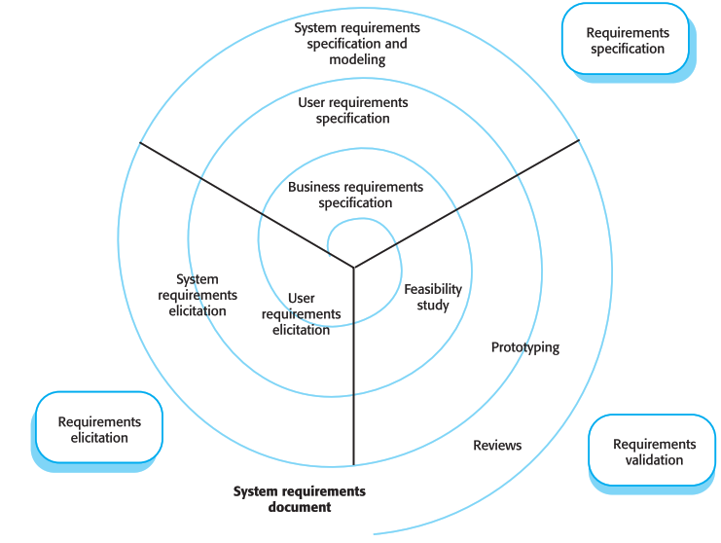
Requirements engineering process
A spiral view of the requirements engineering process

Slide 31
Feasibility studies
A feasibility study decides whether or not the proposed system is worthwhile.
A feasibility study is a short, focused study that aims to answer a number of
questions:
Does the system contribute to the overall objectives of the organization?
2. Can the system be implemented using current technology and within given cost and schedule constraints?
3. Can the system be integrated with other systems which are already in place?

Slide 32
Feasibility study implementation
Based on information assessment (what is required), information collection and report writing
Questions for people in the organization
What if the system wasn’t implemented?
What are current process problems?
How will the proposed system help?
Is new technology needed? What skills?
What will be the integration problems?
What facilities must be supported by the system?
What is the risk associated with cost and schedule?
What are the potential disadvantages/advantages?
Are there legal issues?
Are there issues linked with the fact that this is an offshore project?

Slide 33
Requirements Elicitation and analysis
Problems of requirements analysis
Stakeholders don’t know what they really want
Stakeholders express requirements in their own terms
Different stakeholders may have different requirements
Organizational and political factors may influence the system requirements
The requirement changes during the analysis process.

Slide 34
Requirements validation
Validity Check:
The system should provide the functions which best support the customer’s needs.
Consistency Check:
requirements in the document should not conflict.
Completeness Check:
The requirements document should include requirements, which define all functions and constraints required by the customer.
Realism Check:
The requirements can be implemented with given available budget and technology.
Verifiability:
The delivered system should meet specified requirement.

Slide 35
Enduring and volatile requirements
Enduring and volatile requirements
Enduring requirements:
These are the stable requirements derived from the core activity of the customer organization. E.g. a hospital will always have doctors, nurses, etc. May be derived from domain models
Volatile requirements:
These are requirements which change during development process or when the system is in use. In a hospital, requirements may be derived from government health-care policies.

Slide 36
Requirements management
Requirements management includes planning and change management.
Requirements management planning: Planning is a first stage in the requirement management process.
Requirements identification: The requirements are individually identified.
A change management process: This is the set of activities to assess the impact and cost of changes.
Traceability policies: These policies define the relationships between requirements and between the requirements and the system design.
CASE tool support: Tools that may be used the range from requirement management system to spreadsheets and simple database systems.

Slide 37
Requirements management
Requirements change management
Should apply to all proposed changes to the requirements
Principal stages
1. Problem analysis and change specification. Requirements problems and propose changes are analysed.
2. Change analysis and costing. Effects and costs of change are Assessed on requirements
3. Change implementation. Requirements document ,system design and implementation are Modified.

Slide 38

Thanks to All

